Slide 1


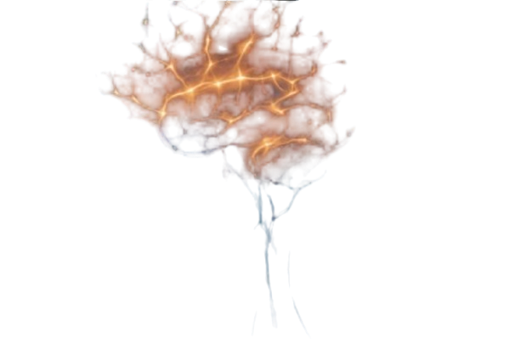
Members:
Shafayat Hasnat Rubaiyat (ID: 2022-3-60-029)
MD Riyad Hossain (ID: 2022-3-60-156)
M. Nura Alam Naim (ID: 2022-3-60-123)
Mehejarin Aklima Jerin (ID: 2022-3-60-325)
Brain Tumor MRI Images Classification for 44 Classes Using Deep Learning

Slide 2

Objectives
Implemented and compared multiple CNN-based architectures for brain tumor detection.
Evaluated baseline, ML classifiers and pre-trained models for this classification criteria.
Identified the best-performing architecture overall with highest accuracy and generalization closest to the best related work accuracy.

Slide 3
Dataset Details
Brain Tumor MRI Images 44 Classes ( A collection of T1, contrast-enhanced T1, and T2 MRI Images of brain tumor)
Images are anonymized ( no patient identifiers or markings).
Covers multiple brain tumor types and normal scans .
Total Images: 4,479. Different classes have different number of images which made this dataset a pure imbalance dataset.
Additionally , for our project purpose we fixed this imbalanced dataset with Augmentation.
All 44 classes visualizations with an Image of each clases , here is the visualization : https://github.com/Infi9itee/AI_GRP_3_Brain_Tumor_Classification/blob/main/results/plots/data_visualizations/different_class_image.png

Slide 4
Model Architectures Overview
Baseline Custom CNN - simple CNN from scratch to set benchmark.
B. Pre-trained models:
1. DenseNet121 - deep architecture with dense connections for efficient feature reuse.
2. EfficientNet - optimized model balancing accuracy and efficiency.
3. GoogleNet(Inception v1) - multi-scale feature extraction via inception modules.
4. ResNet50 - Trained on Raw and Augmented data.
C. Hybrid Model CNN (DenseNet + ResNet) - combined feature extraction from both architectures, achieving the highest accuracy (98.69%)

Slide 5
Model Training Parameters
Image Size: 224×224
Batch Size: 32 (train), 64 (val/test) overall
Augmentation: rotation, flip, affine, brightness/contrast, random erasing
Normalization: mean = [0.485, 0.456, 0.406], std = [0.229, 0.224, 0.225]
Optimizer: AdamW (lr 3e-4 for classifier, 1e-5 for backbone, weight decay 1e-4)
Loss: Cross Entropy Loss (with label smoothing in ResNet)
Scheduler: Cosine Annealing R
Epochs: 20–25 overall
Strategy: Two-phase fine-tuning for GoogleNet & Hybrid

Slide 6
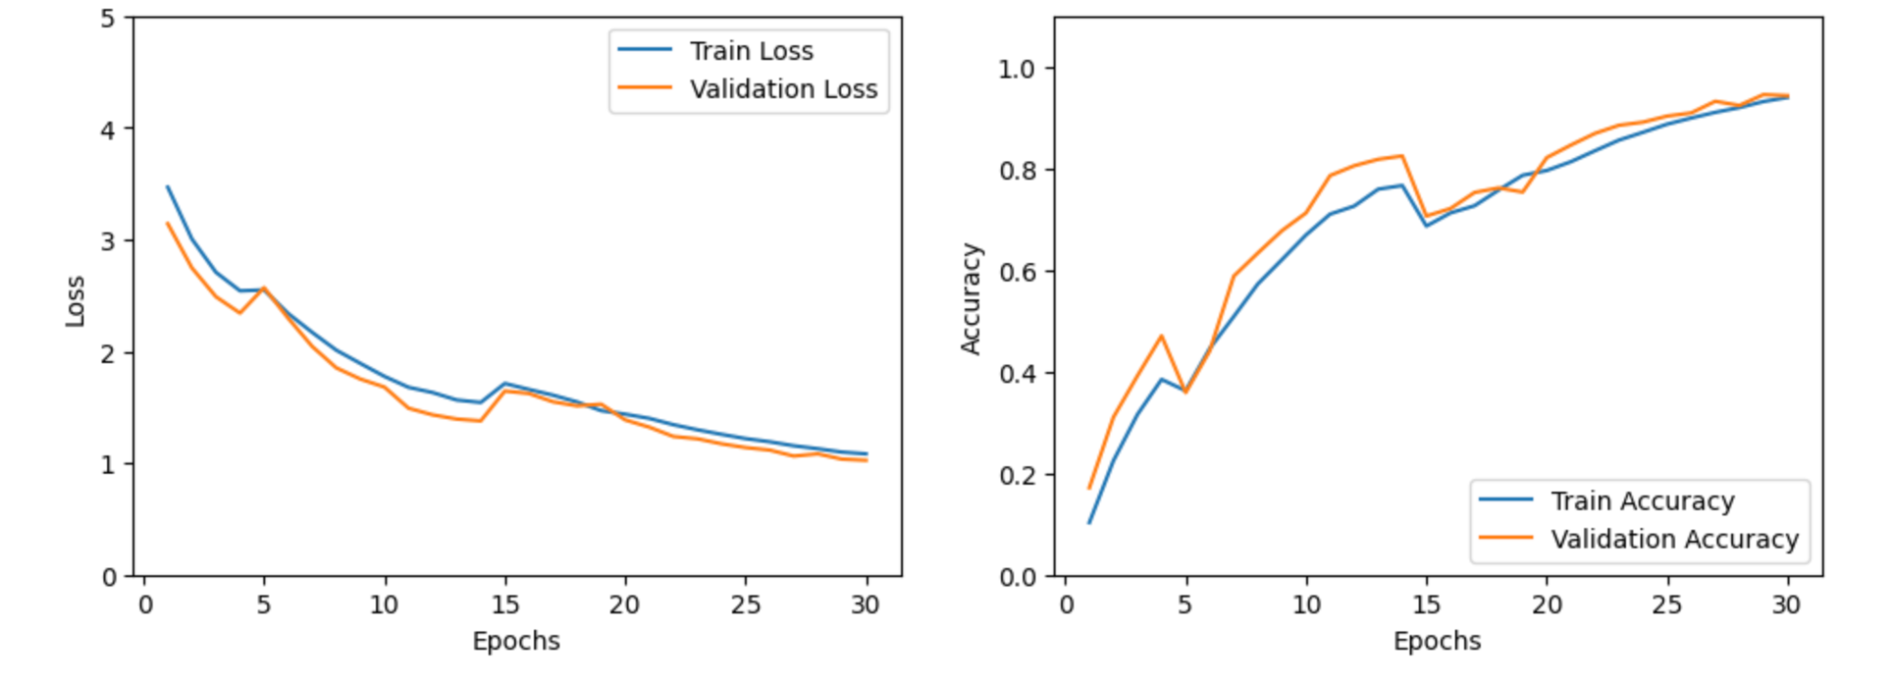
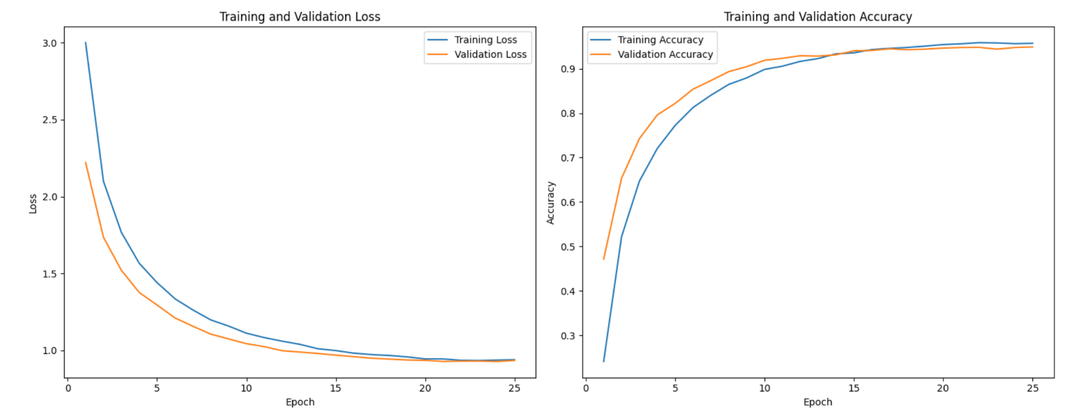
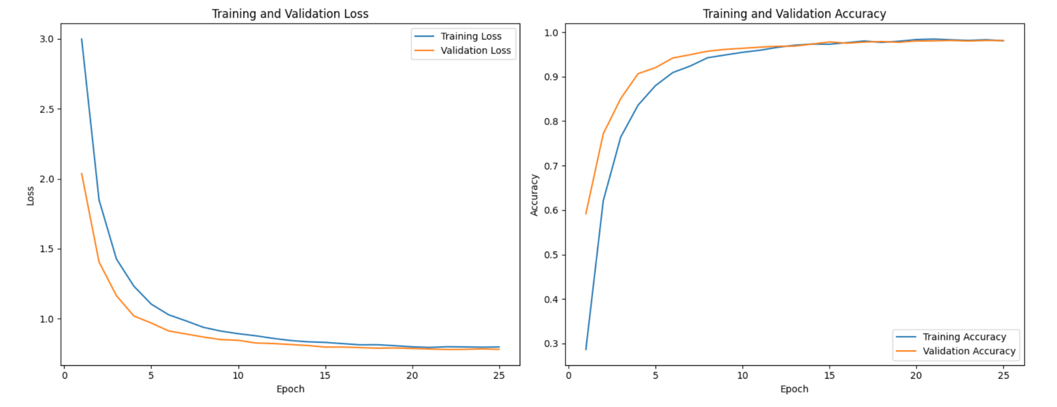
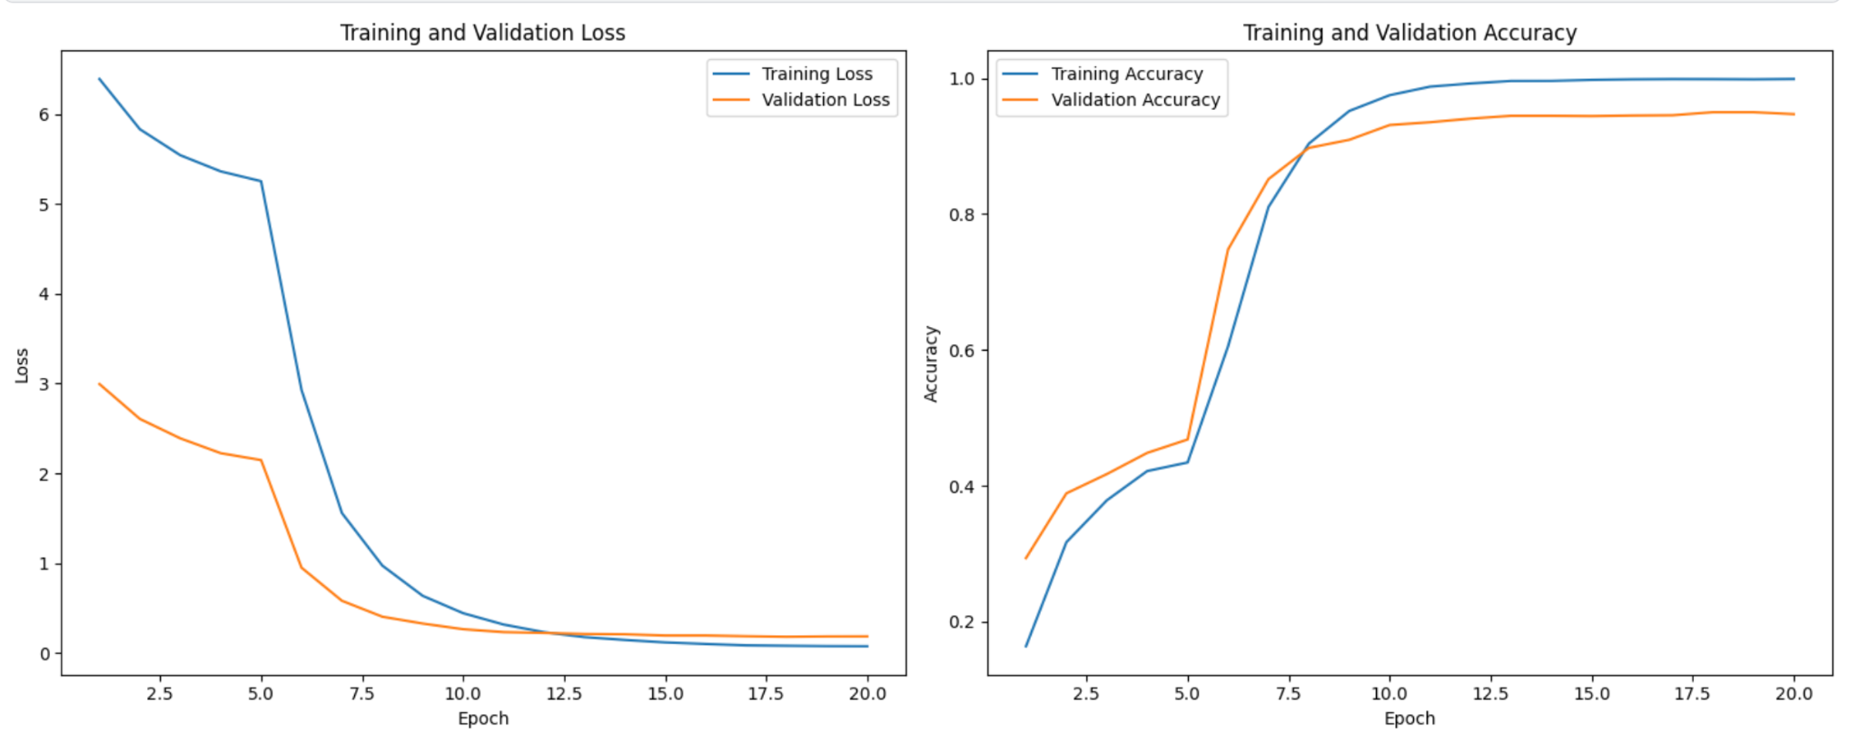
All Models Learning Curves
Baseline Custom CNN: B. Pre-trained Models :
1. DenseNet:
2. EfficientNet: 3. GoogleNet:

Slide 7
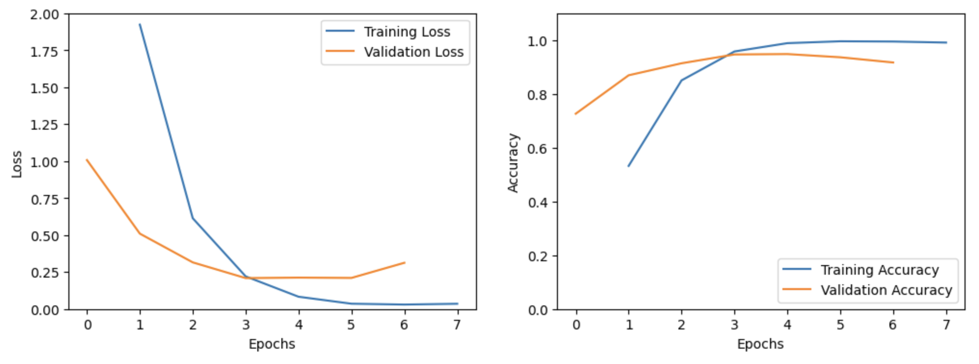
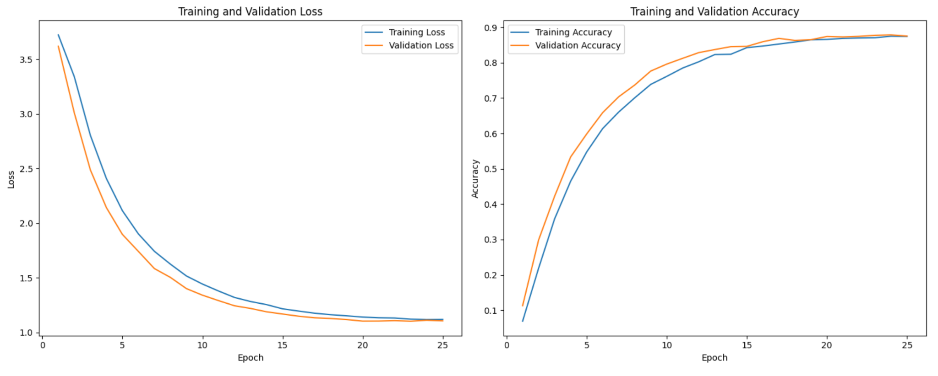
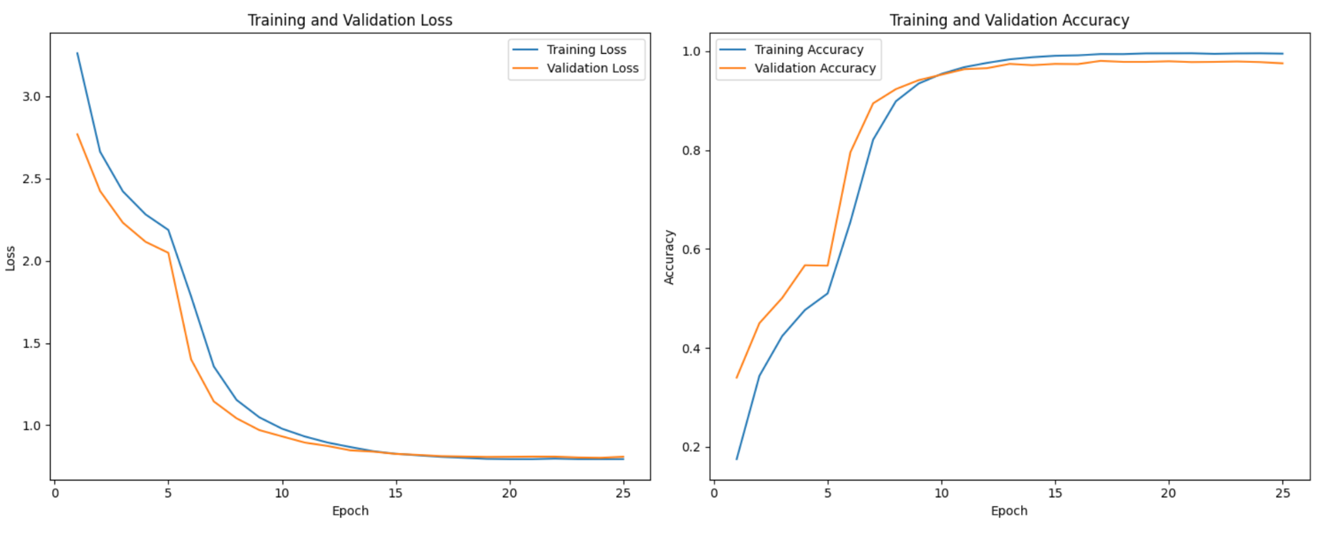
4(a). ResNet on Raw data: 4(b). ResNet on Augmented data:
C. Hybrid Model CNN (DenseNet + ResNet):

Slide 8
Performance Comparison
Models | Accuracy | Precision (W) | Recall (W) | F1-Score (W) | F1-Score (Macro) | Train Time | Test Time | Test Samples
Hybrid | 98.69% | 98.72% | 98.69% | 98.68% | 98.68% | 48.94 min | 9.77 s | 2436
EfficientNet | 97.70% | 97.76% | 97.70% | 97.68% | 97.68% | 22.62 min | 8.10 s | 2436
GoogleNet | 95.94% | 96.03% | 95.94% | 95.90% | 95.90% | — | — | 2436
ResNet50 | 95.50% | 96.00% | 96.00% | 96.00% | 94.00% | 2.51 min | 3.60 s | 672
DenseNet | 94.13% | 94.30% | 94.13% | 94.09% | 94.10% | 30.14 min | 8.79 s | 2436
Custom CNN (Baseline) | 94.00% | 94.20% | 94.00% | 94.00% | 94.00% | 81.97 min | 17.74 s | 2436
Per Class, Per Model Evaluation

Slide 9
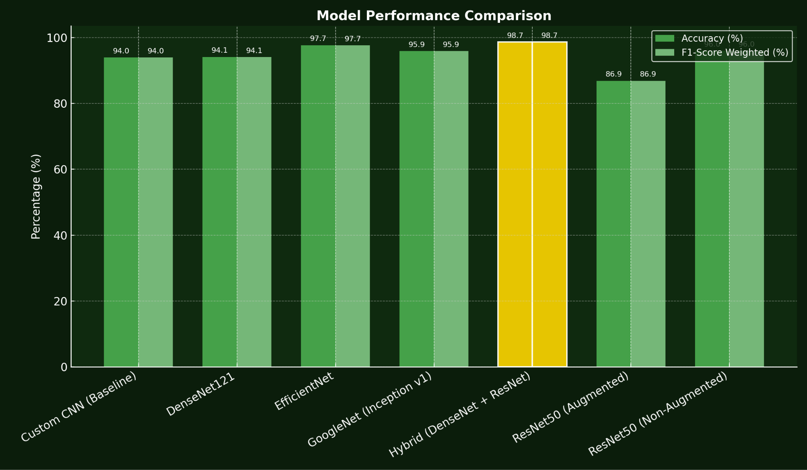
Visual Comparison

Slide 10
Final Best Model Findings
Hybrid CNN (DenseNet + ResNet) is the best performing model, as we’ve seen above the highlighted part of the bar chart.
Achieved 98.69% accuracy with top precision, recall, and f1-score as we’ve seen above in the comparison table the highlighted one.
Combines strengths with backbone of DenseNet & ResNet for better feature learning.
Two-phase fine-tuning + augmentation improved generalization.
Outperformed all baseline and pre-trained models.

Slide 11
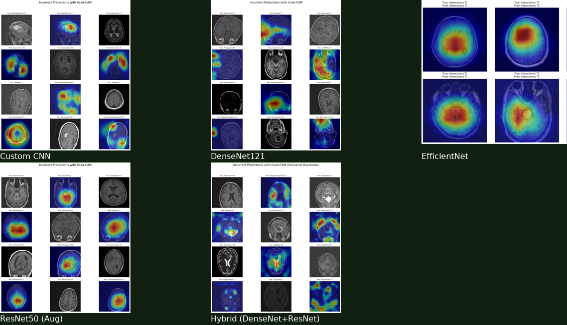
Grad-CAM Visualizations

Slide 12
Generalizability testing
Tested on held-out MRI scans (T1, T1C+, T2).
ResNet50: Non-augmented (95.5%) outperformed augmented (86.9%).
Hybrid (DenseNet+ResNet): Best generalization (98.69% Acc, 98.68% F1), consistent across sequences.
Misclassifications mainly between similar tumor subtypes.
Hybrid balanced highest accuracy with reasonable inference time (~9.8s).

Slide 13
Conclusion
This project demonstrated the effectiveness of deep learning in brain tumor classification using MRI scans. After testing multiple architectures, including Custom CNN, DenseNet, EfficientNet, GoogleNet, and ResNet with both augmented and non-augmented data, the Hybrid CNN combining DenseNet and ResNet achieved the best overall performance with 98.69% accuracy. Grad-CAM visualizations confirmed that the models focus on relevant tumor regions, ensuring interpretability and clinical trust. Furthermore, generalizability testing showed that the Hybrid model remains robust across different data conditions, making it a reliable and accurate solution with strong potential for clinical application and future advancements in medical imaging.

Slide 14
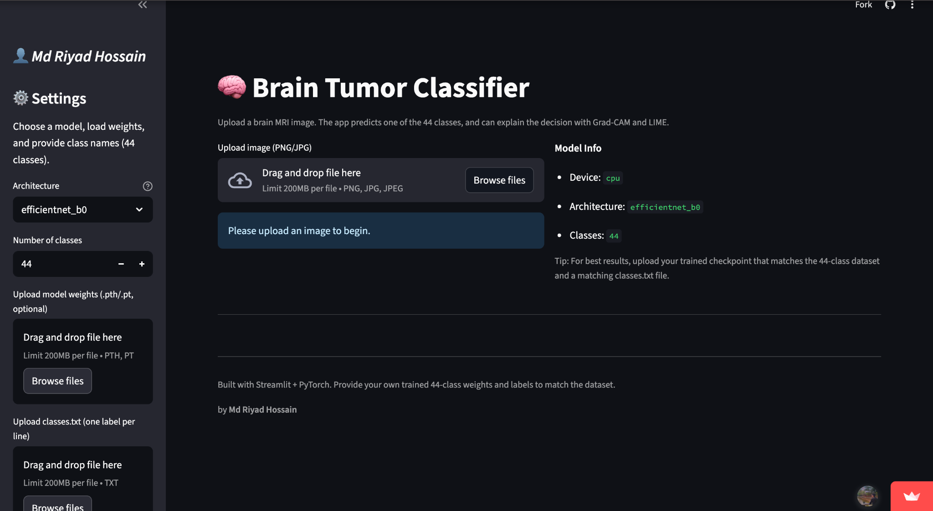
Additional Part : Streamlit App
Live link of the Streamlit App: https://braintumordetection00.streamlit.app/
Landing Page View :

Slide 15
Each Member’s Contribution Percentage
Name | Contribution (%) | Justification
Shafayat Hasnat Rubaiyat | 30% | CNN architecture, Transfer learning experiments
MD Riyad Hossain | 30% | Hyperparameter tuning, Data pre-processing
M. Nura Alam Naim | 20% | Final integration, evaluation, visualization
Mehejarin Aklima Jerin | 20% | Baseline model, Documentation

Slide 16
Thank You

